Slide 1
Liquor Management System
Shraddha Waphare: 50442793
Mitali Deshpande: 50442682
Yash Abhyankar: 50442683

Slide 2
Introduction
Improve retailers inventory logistics.
Reduce inventory handling costs.
Decreases inventory movement.
Identifying trending products.
Forecast customer demands.

Slide 3
Problem Definition
Inability to continuously improve merchandise planning.
Need to comprehend the connection between consumer behaviour, product demand, and external environment variables.
Desire to find the unique correlations between the demand influencing factors that would improve sales.

Slide 4
Dataset
Iowa State liquor dataset.
3.5 Gb
Data over 3 years
Attributes: store number, zip code, county number, date, sales (price), volume sold.

Slide 5
Scope of Project
This project will depict the retailer’s view in supply chain management.
Aspects related to profit maximization are included.
Retailer can view the results in the form of tables.

Slide 6
Trends
Overall sales prediction
Sale of each particular item
Quantity prediction of an item
Sales prediction of an item in a particular store

Slide 7
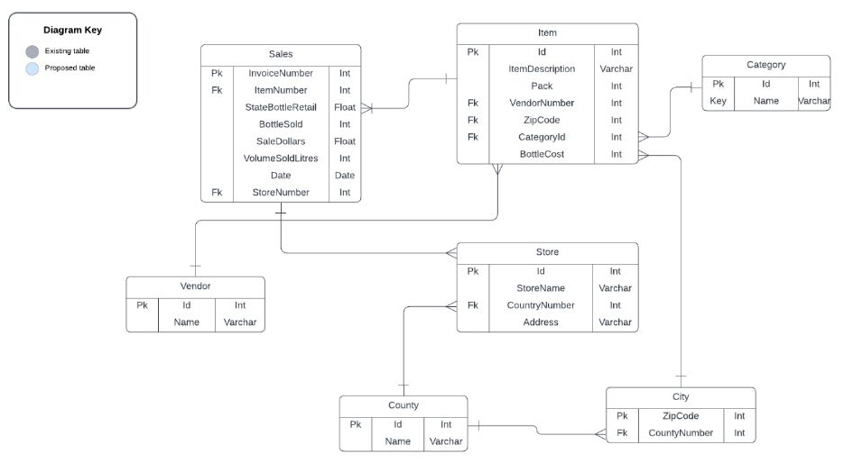
Milestone 1 ER Diagram

Slide 8
Normalization

Slide 9
1NF
A table is in 1NF if all columns contain only atomic values.
Multi-values not present in any column
Dataset thus in 1NF

Slide 10
2NF
Condition to be in 2NF is the table should have no partial dependency present in it.
We considered Items Table
It contained Item Number, Description, Category ID, Vendor Number, Zip code and Bottle cost
Vendor number and Zip code alone could not decide the value of item.
Hence, partial dependency existed and we removed them.

Slide 11
3NF
Table is in 3NF if no transitive dependency exists for non prime attributes.
Sales table: Item Number, Invoice Number, State bottle retail, Bottle sold, Sale dollars, Date, Volume sold and Store Number.
Sale dollars product of State bottle retail and volume sold.
Transitive dependency
Removed it
Table in 3NF

Slide 12
BCNF
Must satisfy two conditions:
Table in 3NF
For any dependency X Y, X must be a Candidate or Super key
Schema already in 3NF
All tables had a candidate key.

Slide 13
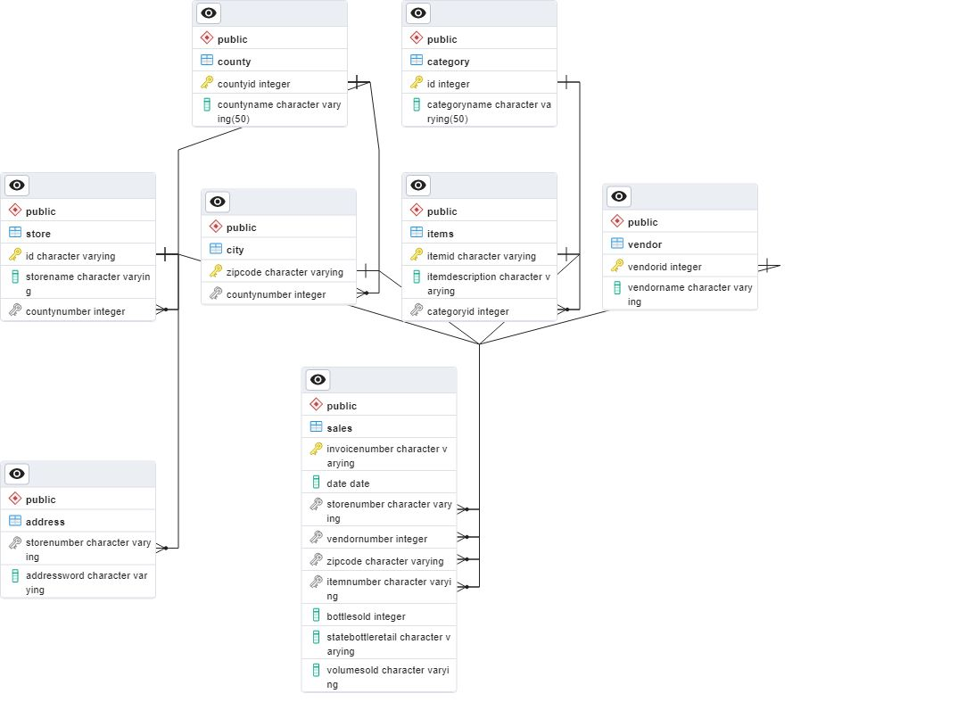
Updated ER Diagram

Slide 14
Queries Executed

Slide 15
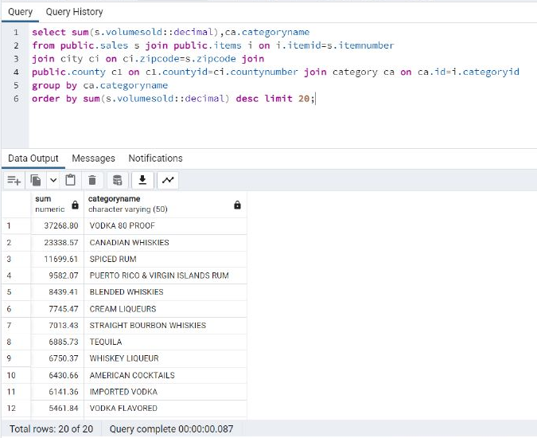
1. Total sales of liquor of a single category for all the stores in descending order (Top 20)

Slide 16
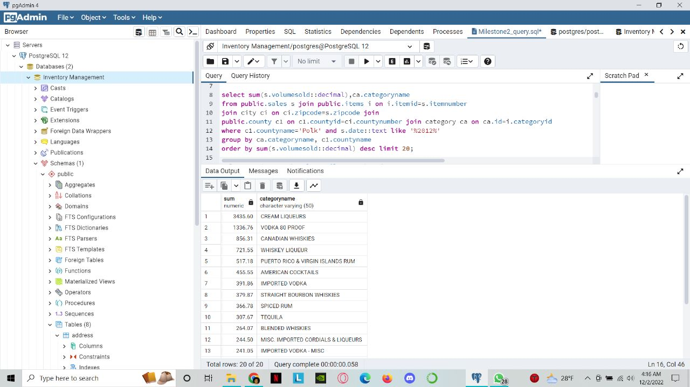
2. Highest selling category of liquor for a particular county in a particular year

Slide 17
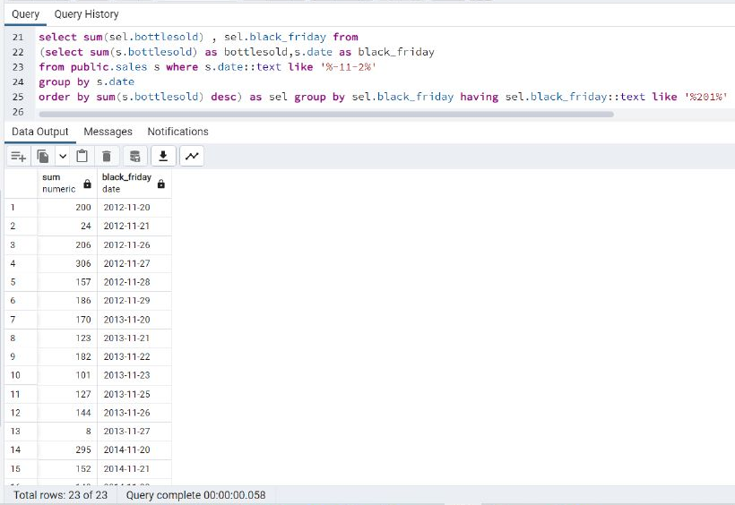
3. Black Friday sales for individual year

Slide 18
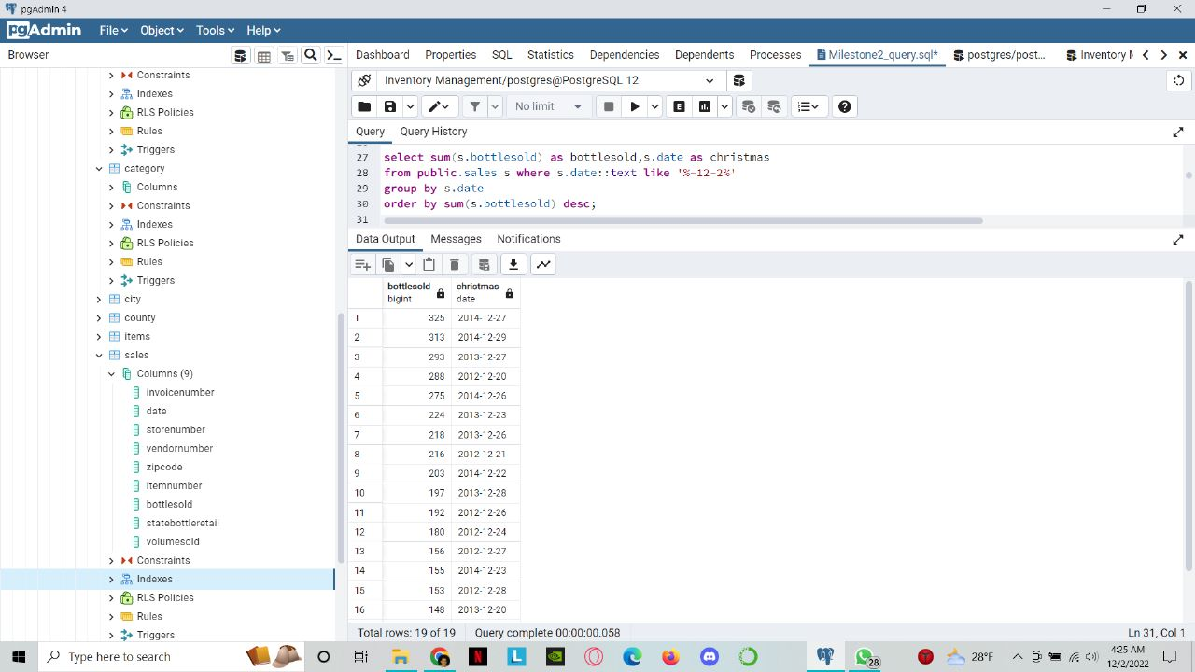
4. Christmas sales for individual year

Slide 19
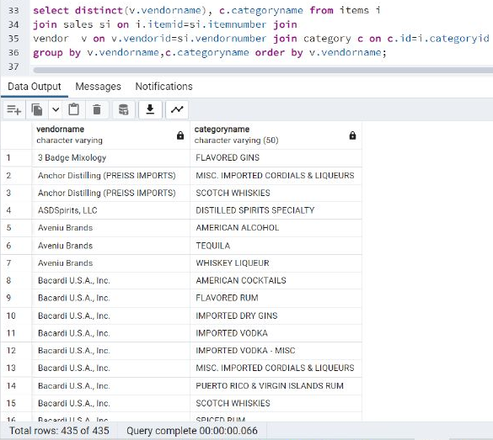
5. List of all the liquor categories sold by individual vendors

Slide 20
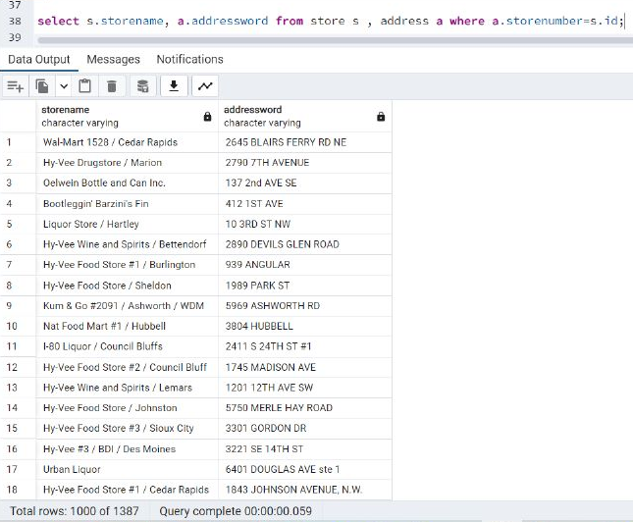
6. List of all Store names and their addresses

Slide 21
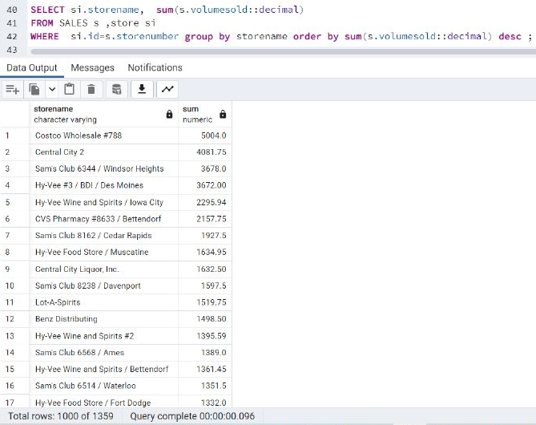
7. Highest total sales store wise

Slide 22
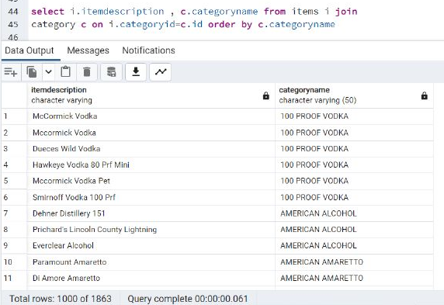
8. Items present in a particular category

Slide 23
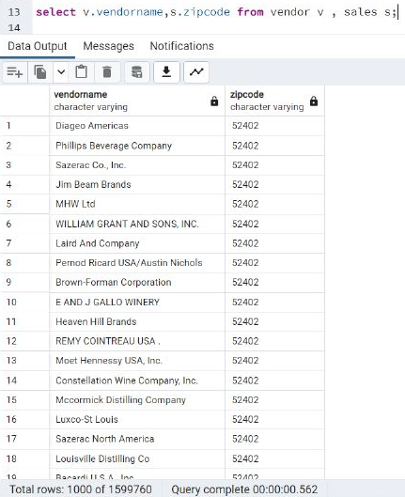
9. Vendors present in a particular Zip code

Slide 24
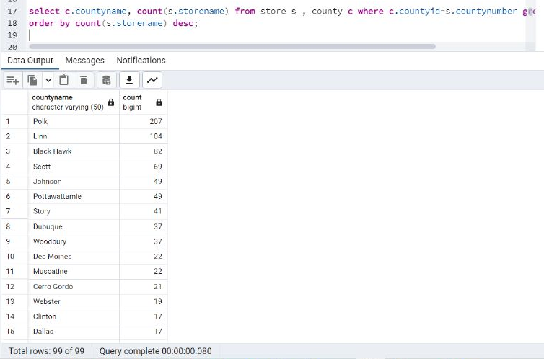
10. Total number of stores in individual county

Slide 25
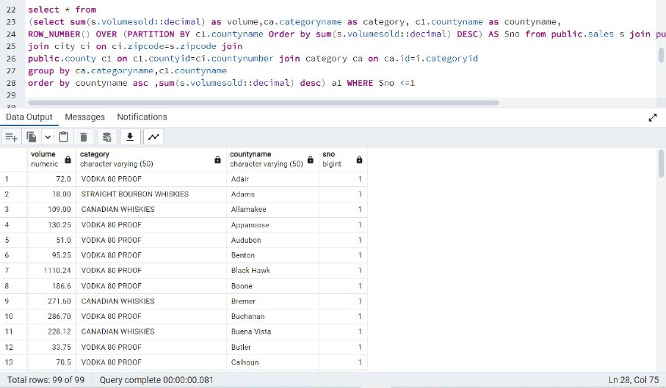
11. Highest selling category of liquor in every county

Slide 26
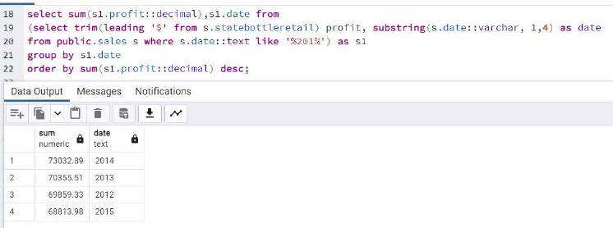
12. Yearly liquor revenue for Iowa state

Slide 27
Thank You

